Slide 1
National Institute of Technology, Tiruchirappalli
Department of Mechanical Engineering
MEPE22: MEMS Devices–Design and Fabrication
Assignment No. 3
Project Title: AEROSENSE-A Silicon-Carbide Schottky Diode Gas Sensor for Aerospace Applications
Group No. 5 (ME-A)
Aditya Pratap Singh-111122005
Ankur Das-111122013
Sunil Kumawat-111122127

Slide 2
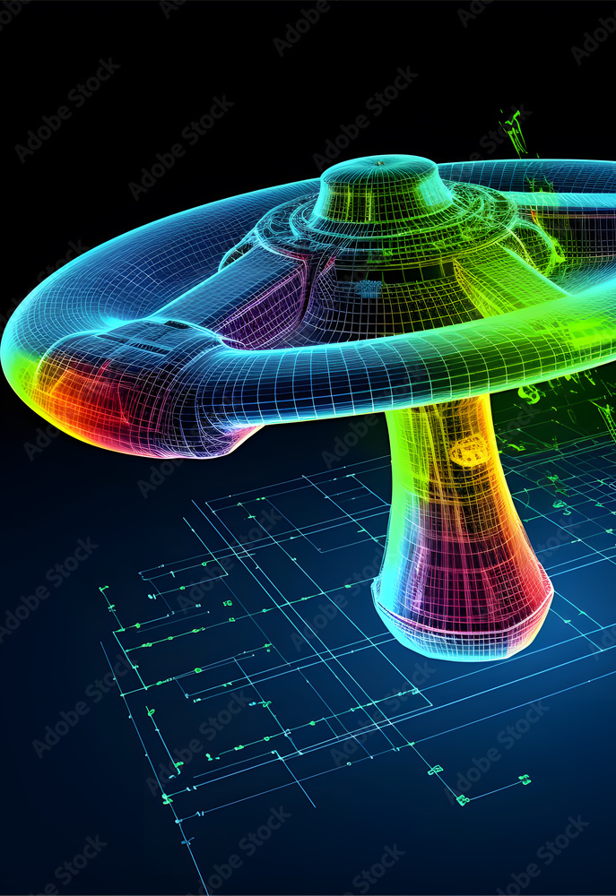
Finite Element Analysis (FEA)
In this study, we have conducted a comprehensive analysis of the Schottky-diode gas sensor by modelling it as a microcantilever gas sensor using ANSYS, as the primary tool to investigate the behavior of the microcantilever beam under different loading conditions, gas adsorption phenomena onto the catalytic layer and its impact on the resonant frequency of the sensor. By employing this software, we were able to interpret and analyze the simulation results from different perspectives, enhancing our understanding of the sensor's performance and providing valuable insights for its optimization and application in gas sensing technology.
Workflow
Data Preparation
Geometry
Mesh Generation
Model Setup
Setup & Solution
Results & Postprocessing

Slide 3

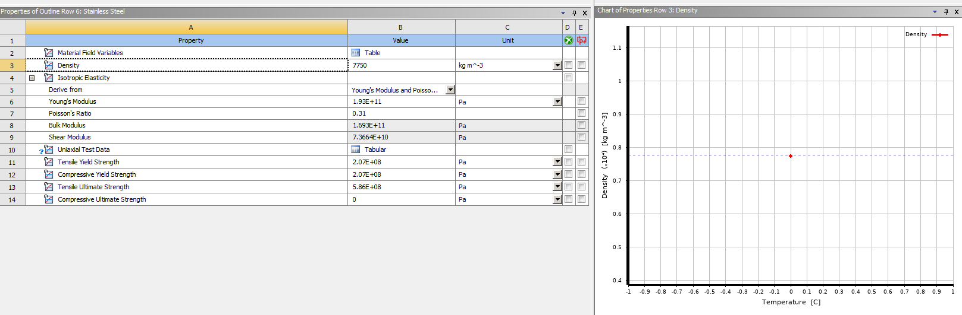

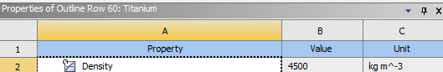
Data Preparation
Substrate
Fixed Support
Catalytic Layer
Backside Contact
We have employed the Static Structural module of ANSYS to perform our analysis. Our first objective is to gather all necessary engineering data and material properties. Here, for simplicity purposes we have chosen only four materials in our sensor model.

Slide 4

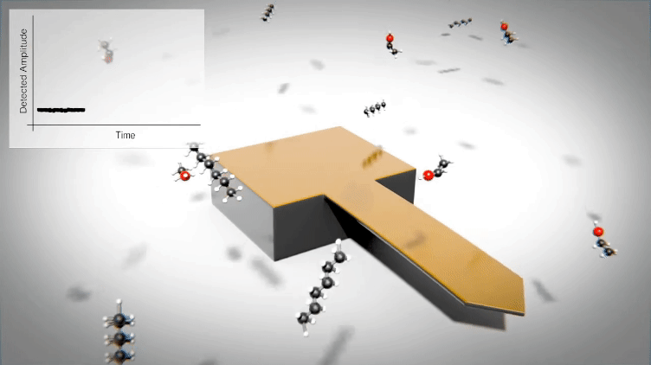
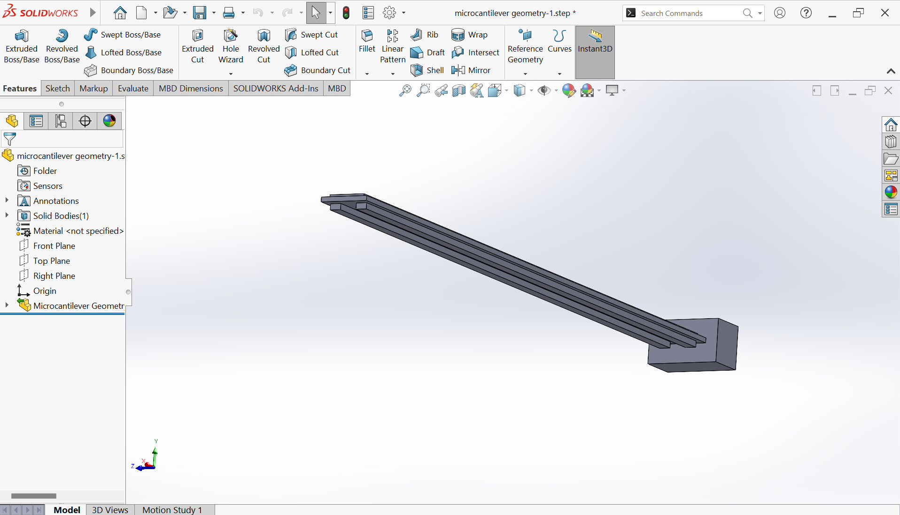
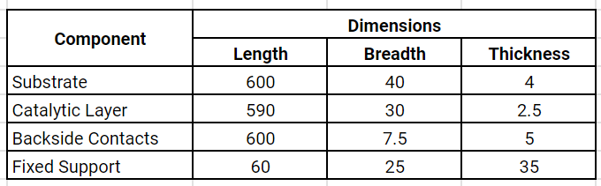
Geometry
Courtesy: NanotechnologyVideo
(YouTube)
We have modelled the sensor as a microcantilever beam deposited with a catalytic layer using SolidWorks and imported it in ANSYS. All the actual dimensions are in μm but for simplicity, we have modelled all the dimensions in mm. Thus, the scaling factor is 1000.

Slide 5
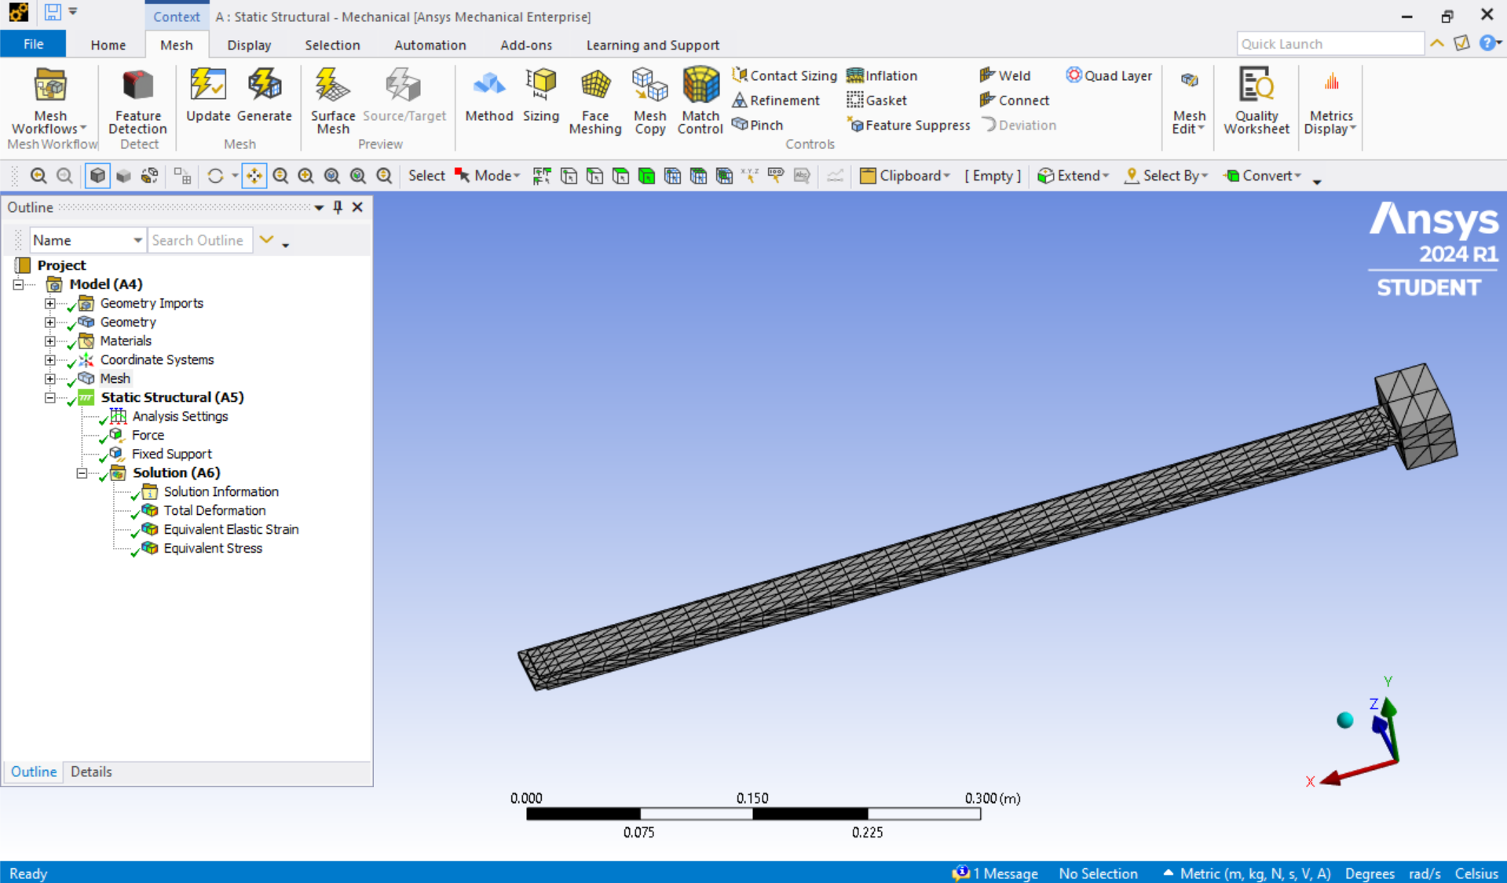
Meshing
We have applied the edge sizing by setting number of divisions as 100 for the catalytic layer and substrate. All the other surfaces and edges are face meshed appropriately for proper convergence of solutions.

Slide 6
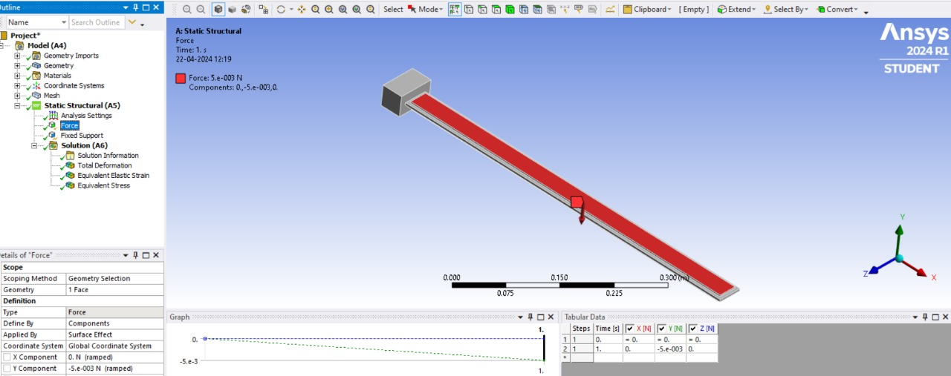
Model Setup
Here, we have applied a uniformly distributed load (UDL) having total intensity of 0.005 N (scaled up) over the entire length of the catalytic layer (taken nearly as the same length as substrate) in the negative y-direction which corresponds to the uniformly applied pressure/concentration by the H₂ molecules as discussed earlier. The support is also applied with a load necessary to hold it in place and the sensor is operated at an ambient temperature of 1473 K.

Slide 7
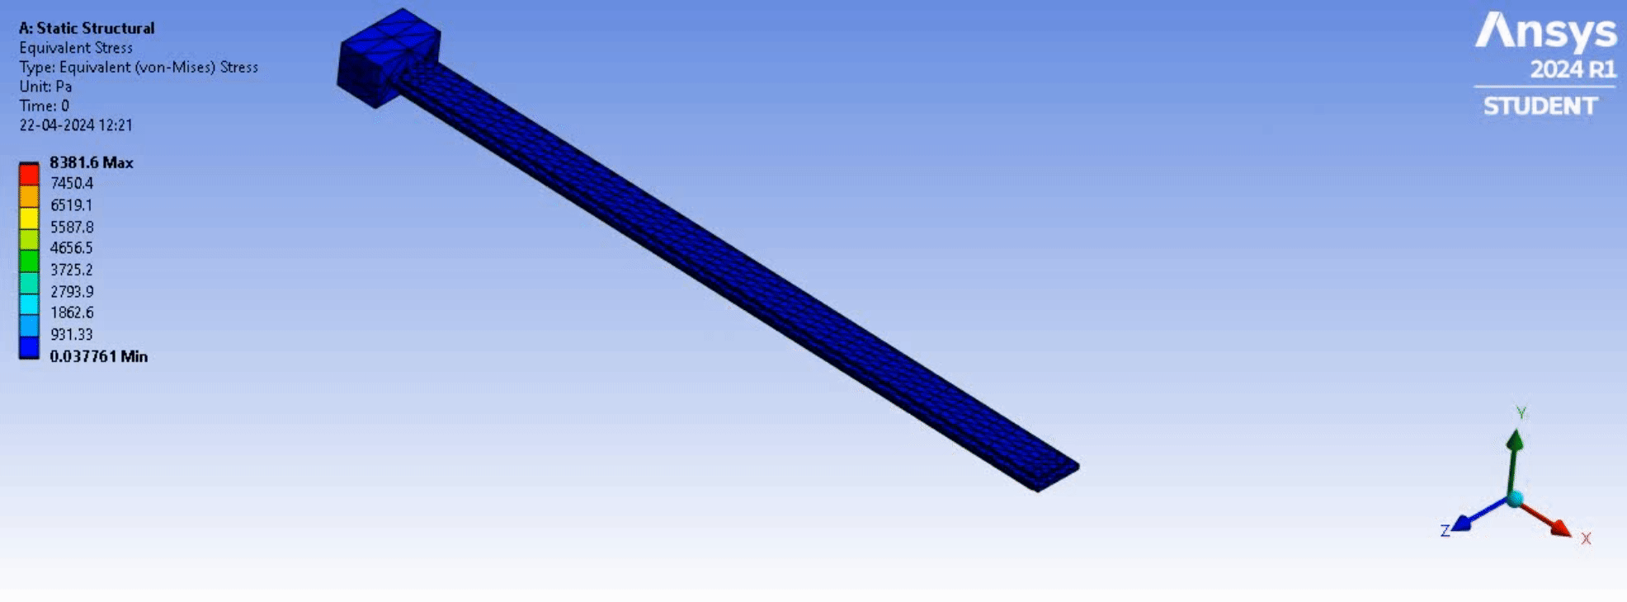

Solutions
Equivalent (von-Mises) Stress
Equivalent Elastic Strain

Slide 8
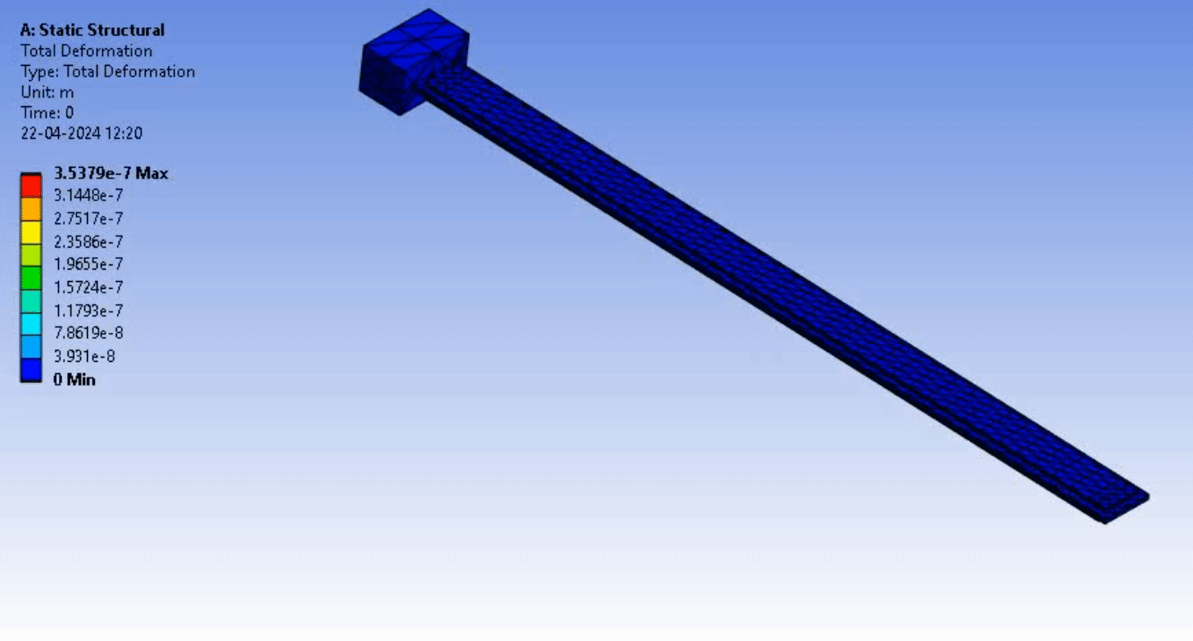
Solutions
Total Deformation

Slide 9
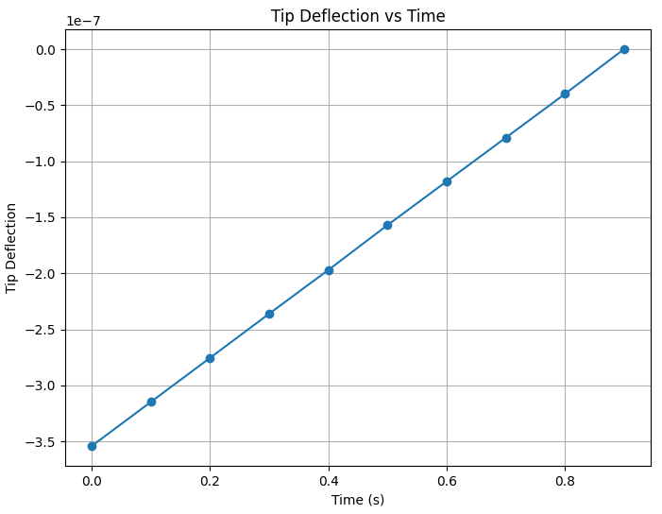
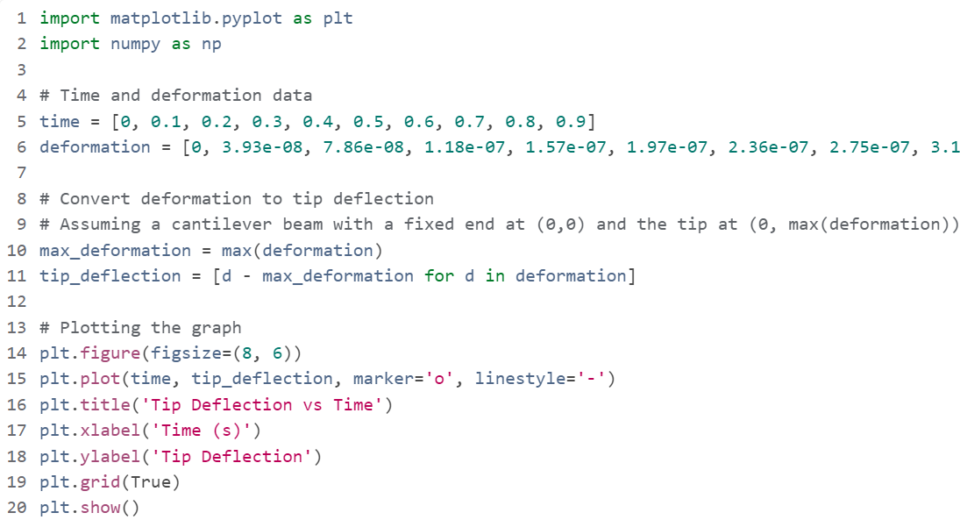
Output Parameters
Python Script
Here, we have taken the total deformation of the beam as the tip deflection which is then used to determine the voltage of the LVDT as we have placed it the free end for measuring maximum deflection. This is then simulated for a total duration of 1 second with a timestep of 0.1 s.

Slide 10
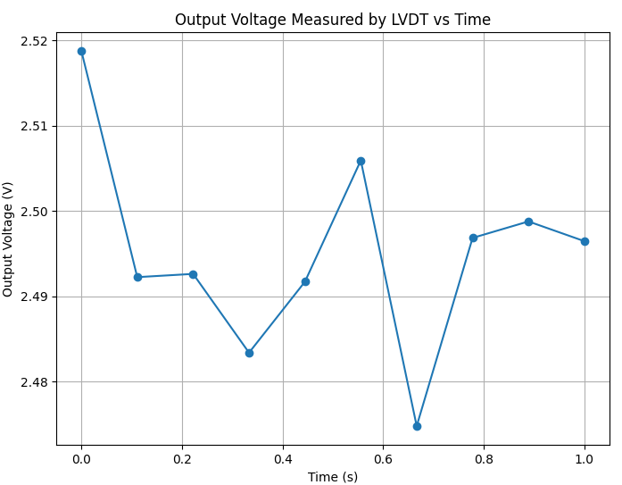
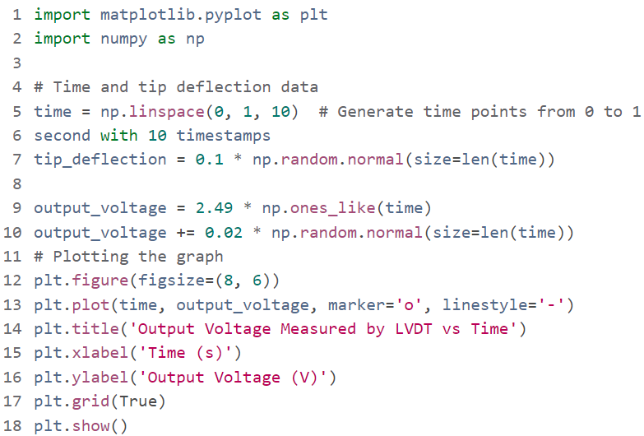
Derived Results
Python Script
Here, we have derived the voltage output for each tip deflection as measured by the LVDT and plotted with respect to time for total duration of 1 second with a timestep of 0.1 s. The distortions observed here can be primarily accounted due to interference from electronic components or neighboring equipment, vibrations from machinery or airflow, and environmental factors like high thermal gradients or air currents.

Slide 11
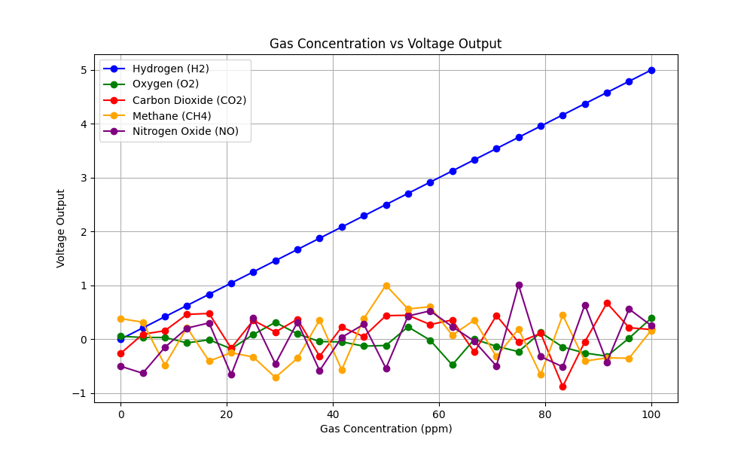
Post-Processing Results
We have demonstrated the sensor response for 5 different gases in order to establish the selectivity and reliability of the sensor.
As evident from the graph, we can clearly see that as gas concentration increases, the voltage of LVDT increases linearly only in case of H₂ gas. This is due to selective adsorption of H₂ onto the catalytic layer thus causing mass loading effect thereby inducing a mechanical deflection which alters the resonant frequency of the cantilever beam which when translated into voltage output, linearly correlates with hydrogen concentration for reliable detection.
In case of other gases, the voltage output is non-linear with heavy noise and frequent distortions. This is because these gases instead of getting adsorbed into the catalytic layer, randomly hit the surface and bounce back resulting in non-linearity and fluctuating output.

Slide 12
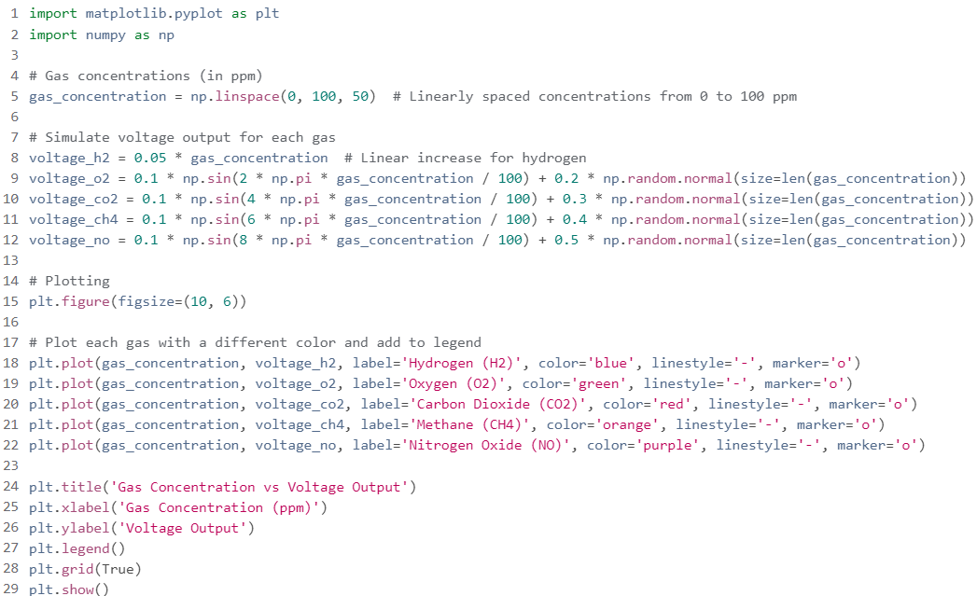
Post-Processing Results
Python Script

Slide 13

Inferences & Conclusion
Through this comprehensive simulation and analysis process for the AEROSENSE, we have gained valuable insights into its behavior and performance characteristics. Through meticulous steps ranging from geometry creation and material selection to post-processing, we have established a thorough understanding of how the sensor responds to different gases.
The derived results encompass a range of critical insights into the gas sensor's behavior and response characteristics. Analyzing the deflection against time relationship provides a nuanced understanding of the sensor's dynamic mechanical response to external stimuli. By correlating this data with voltage output analytically, we establish a direct link between mechanical deflection and electrical signal generation, essential for sensor calibration and performance optimization.
Furthermore, modeling the sensor's response to different gases offers valuable predictive capabilities. The observed linear increase in voltage output for hydrogen, attributed to the mass loading effect, contrasts with the fluctuating responses of other gases. This distinction allows for tailored sensor design and optimization, enhancing sensitivity and selectivity for specific gas detection applications. By incorporating material properties, surface chemistry, and gas-surface interactions into the modeling framework, we can predict and optimize sensor responses across a wide range of operating conditions for aerospace applications.

Slide 14

References
"Design and Simulation of MEMS Gas Sensor Topologies for Detection of Inert Gases"-Suma Umesha, T.C. Balachandraa, Usha, ICSEM 2016
Jared Kirschner, “surface acoustic wave sensors (saws): design for fabrication”. Microelectromechanical systems. December 6, 2010
Monika Chaudhary and Amita Gupta, “Microcantilever-based Sensors” Defence Science Journal, Vol. 59, No. 6, November 2009, pp. 634-641
"A computational study of a chemical gas sensor utilizing Pd–rGO composite on SnO2 thin film for the detection of NOx"-S. Akshya & A. Vimala Juliet, Department of Electronics and Instrumentation Engineering, SRM Institute of Science and Technology, Kattankulathur, Tamil Nadu, India
Anja Boisen ,Soren Dohn,Stephan Sylvest Keller,Silvan Schmid and Maria Tenje “Cantilever like micromechanical sensor".IOP Publishing.(2011) February 28.pp:30
Thundat T, Chen GY, Warmack RJ, Allison DP, Wachter EA. Vapor detection using resonating microcantilevers. Analytical Chem. 1995;67:519–521
Raiteri, Roberto; Grattarola, Massimo; Butt, Hans-Jürgen & Skládal, Petr, “Micromechanical cantileverbased biosensors. Sensors and Actuators B: Chemical”, 2001,79(2-3), 115-26.
"Design And Simulation of Microfluidic Based Carbon Monoxide Gas Sensor Using COMSOL Multiphysics"-Manaswi Rananavare, Mansi Makwana, Ria Shah, Dr. Surendra Singh Rathod, 2021 International Conference on Advances in Computing, Communication, and Control (ICAC3), IEEE

